Slide 1
Website Portfolio
Magento
Oscommerce
Wordpress
Joomla
Social Media
Website Designs

Slide 2
Magento Websites
Jewelry website
Shopping website
Bakery website
Shopping cart
Shopping website

Slide 9
OS Commerce Website
Jewelry Website
School Website
Shopping Website

Slide 13
Wordpress Websites
Company Website
Wordpress Website
Sports Website

Slide 15
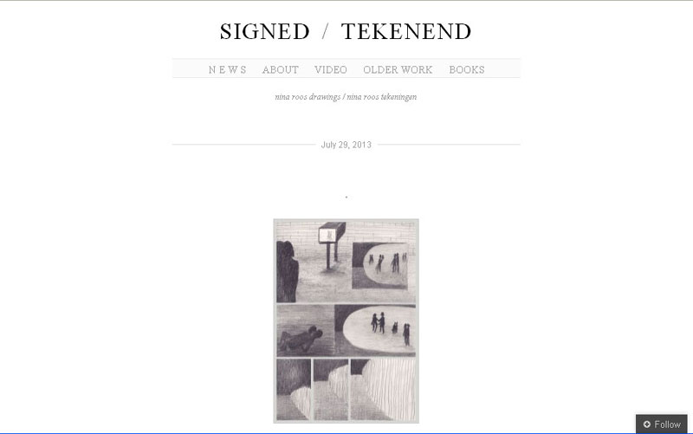

Slide 16
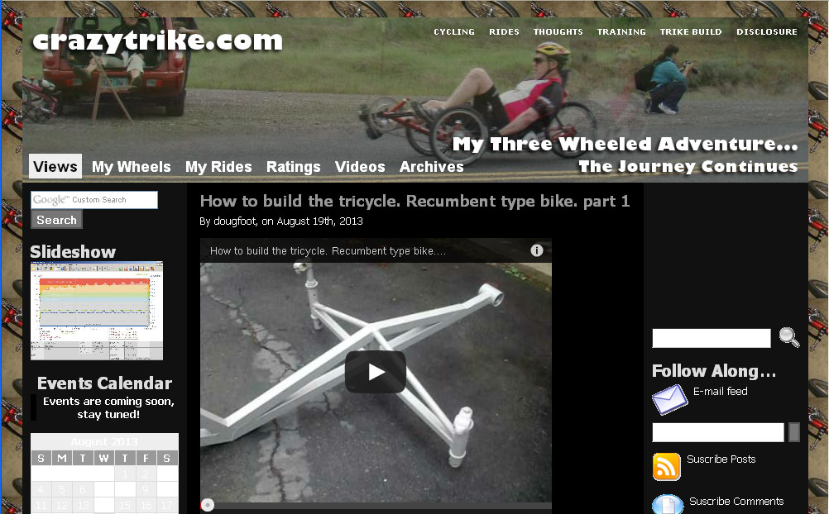

Slide 18
Joomla Websites
Shopping Website
Beauty Product website
Choreography website
Pharmaceuticals website

Slide 22
www.rhizome.org

Slide 23
Social Media
Shopping cart
Easy to use, easy to maintain, easy to modify

Slide 24
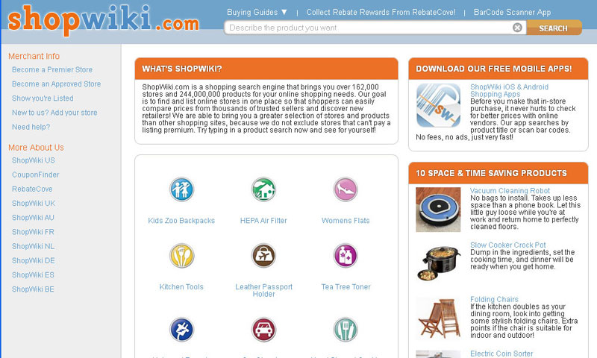
www.rhizome.org

Slide 25
Website Design
Audio Solutions Website
Insurance Website
Education Website
Shopping Website

Slide 29
www.rhizome.org

Slide 31
Thank You !

